Slide 1
CUSTOMER BEHAVIOR / EXECUTIVE READOUT
Customer behavior points to three growth moves
Protect loyalty. Convert more subscribers. Control discount leakage.

Slide 2
01 — CUSTOMER BASE
3,900 purchases reveal a healthy but under-converted customer base
The demand is real. The next unlock is participation.
3,900
$59.76
3.75 / 5
Purchases in the dataset
Average purchase amount
Average review rating
27%
73%
Customers subscribe
Customers do not subscribe
Customer behavior points to three growth moves
2

Slide 3
02 — EXECUTIVE TAKEAWAY
Three growth moves stand out
The evidence points to a balanced agenda, not one oversized bet.
01
02
03
Protect loyalty
Convert more subscribers
Control discount leakage
Loyal customers are the dominant segment: 3,116 customers.
Non-subscribers generate more total revenue because they are the larger group: $170,436 versus $62,645.
Discount-heavy products show clear margin-management candidates.
Customer behavior points to three growth moves
3

Slide 4
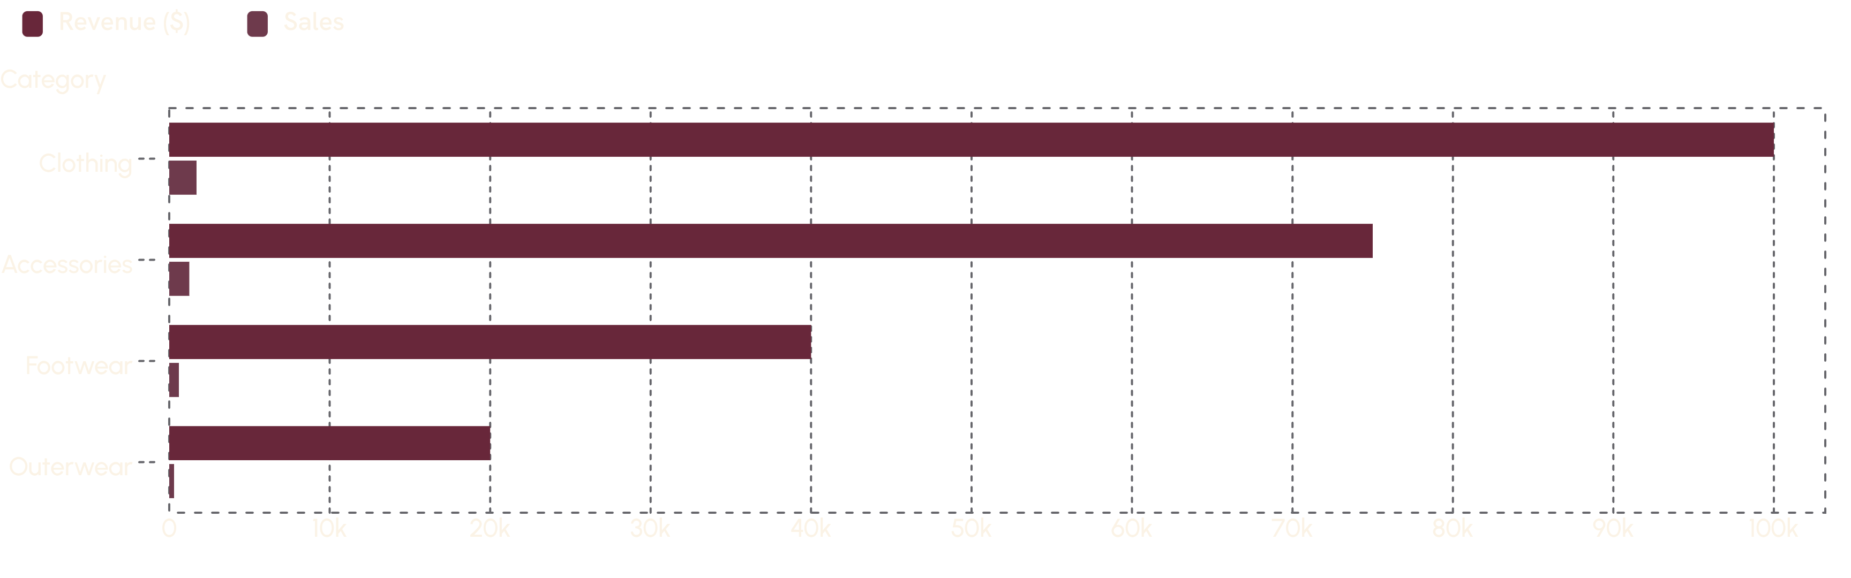
03 — CATEGORY PERFORMANCE
Clothing leads the commercial engine
Clothing leads both revenue and sales volume, with a clear step down to the other categories.
Use category leadership to anchor campaigns, then build targeted plays for smaller categories.
Customer behavior points to three growth moves
4

Slide 5
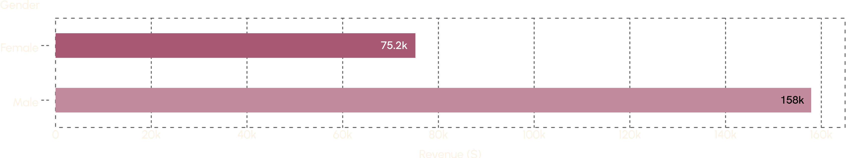
04 — CUSTOMER MIX
Male customers drive more revenue in this dataset
Male-customer revenue is higher in the observed transactions.
Male-customer revenue: $157,890
Female-customer revenue: $75,191
Use this as a campaign allocation signal, not a blanket assumption about customer value.
Customer behavior points to three growth moves
5

Slide 6
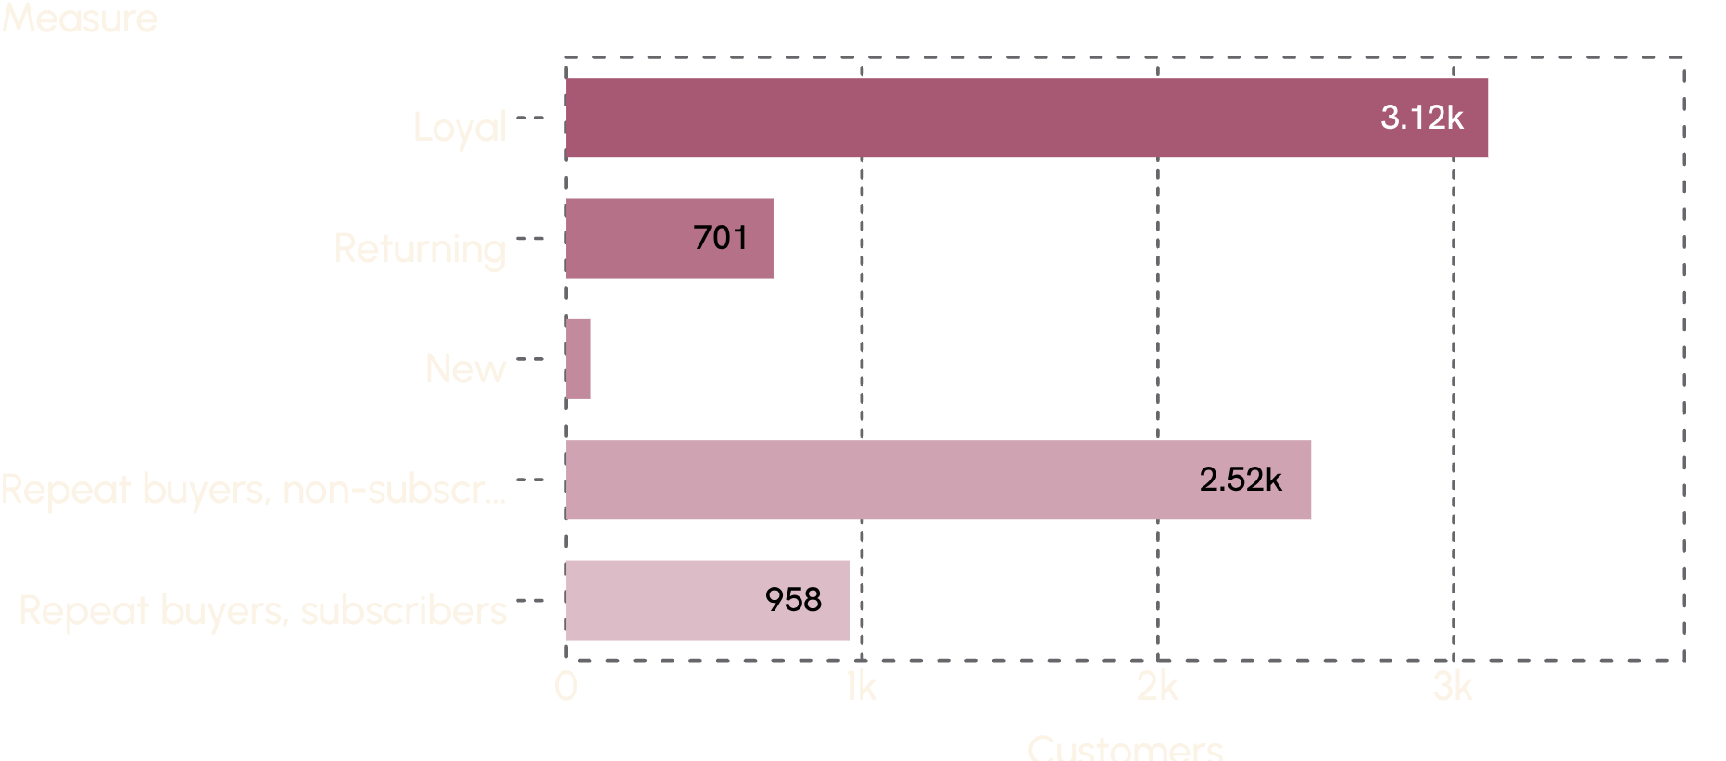

05 — LOYALTY & SUBSCRIPTION
Loyalty is strong; subscription is the open conversion opportunity
The customer base is heavily loyal, while repeat buyers remain largely outside the subscription program.
THE OPEN MOVE
Connect repeat-purchase behavior with a clearer subscription benefit.
Customer behavior points to three growth moves
6

Slide 7
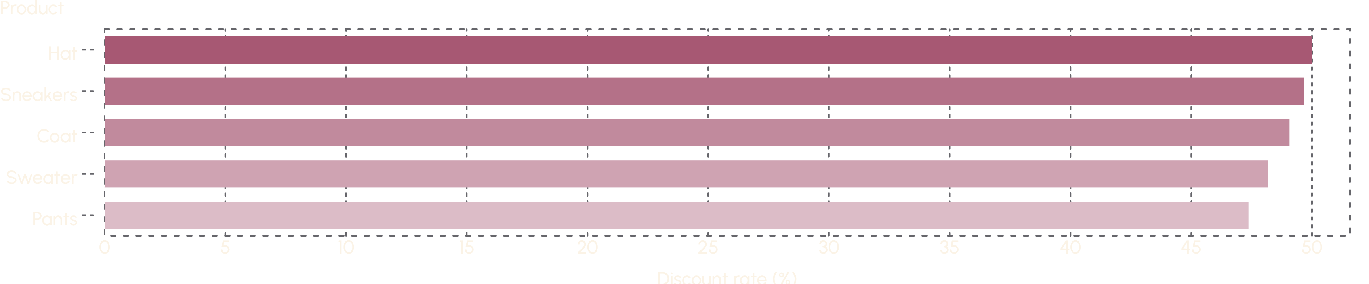
06 — PRICING DISCIPLINE
Discounts are concentrated in products where pricing discipline matters
Five products have discount rates near 50%, creating a focused margin-management list.
839 customers used discounts and still spent above the average purchase amount.
Prioritize tests that separate incremental demand from margin giveback.
Customer behavior points to three growth moves
7

Slide 8

07 — CAMPAIGN SIGNAL
Top-rated products can carry the next campaign wave
Pair proof of satisfaction with the products that already have demand.
Top five by average rating:
Gloves 3.86
Sandals 3.84
Boots 3.82
Hat 3.80
Skirt 3.78
Best-selling products by category include Jewelry, Blouse, Sandals, and Jacket.
Customer behavior points to three growth moves
8

Slide 9
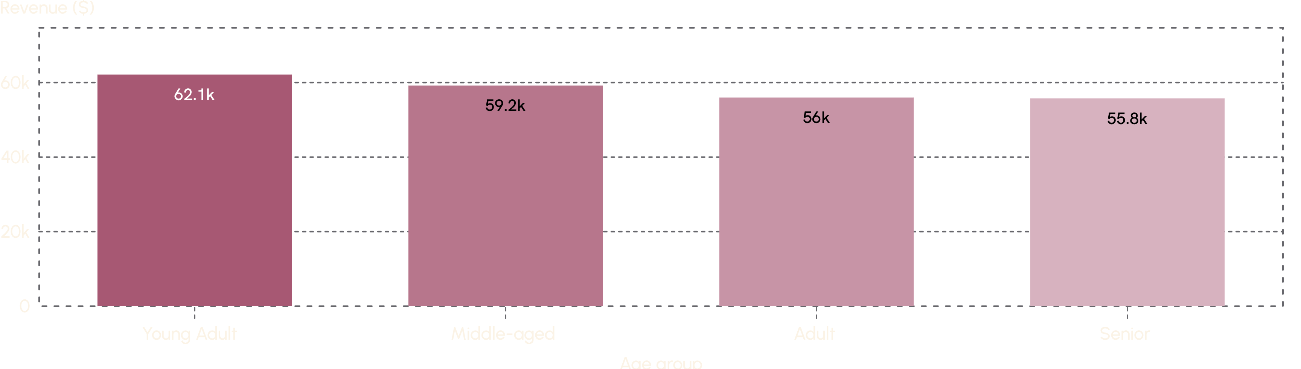
08 — AGE MIX
Young adults contribute the most revenue, but every age group matters
Young adults lead revenue, with a relatively balanced contribution across the other groups.
The spread is meaningful but not extreme, supporting differentiated messaging rather than exclusion.
Customer behavior points to three growth moves
9

Slide 10
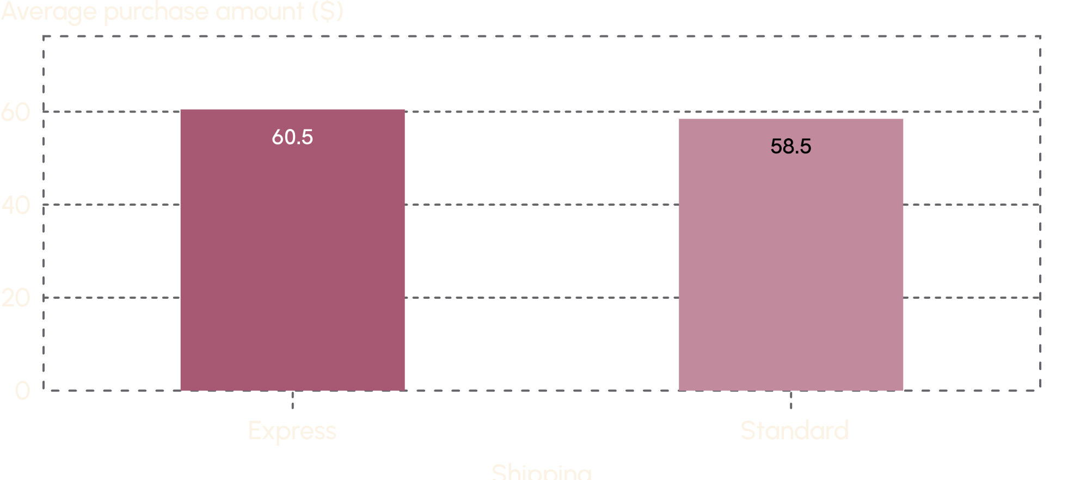
09 — SHIPPING SIGNAL
Express shipping slightly lifts average order value
Use shipping as a value proposition to test alongside subscription benefits
$60.48
Express average purchase amount
$58.46
Standard average purchase amount
Measure conversion and margin together before scaling
Customer behavior points to three growth moves
10

